Slide 1
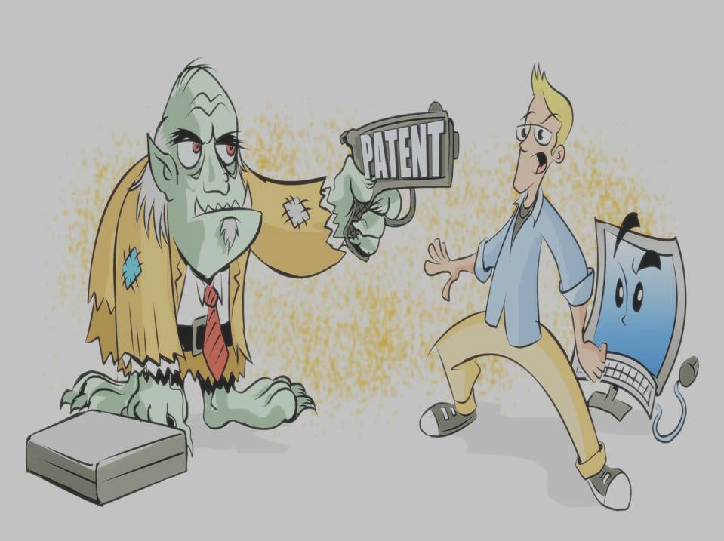
Patent Infringement

Slide 2
Exclusive Rights of a Patent Holder
An issued patent gives the patent owner right to prevent others from
making or using;
selling;
offering for sale in the country; or
importing into the country in which a patent is granted
Starts from the date of publication and last until the expiry of patent term
Enforce his/her patent rights only after the patent is granted

Slide 3
Patent Infringement
If any person exercises the exclusive rights of the patent holder without permission within the country of patent grant and during the patent term
A person is liable for infringement if his product or process is same as the patented invention

Slide 4
Patent Infringement (Cont.)
As claims in a patent define boundaries of the invention claimed, a product or process patent will be infringing if it falls within the scope of a claim in the patent
Therefore, understanding the meaning and scope of patent claims is important for determining infringement

Slide 5
Example patent claim
Claim 1:
A pharmaceutical composition, comprising:
element A; element B; element C; and
element D (your improvement)
Competitor can sue you if they own any of A, B, or C
You can sue if competitor makes, uses, sells, offers to sell, or imports all of A+B+C, and D

Slide 6
Types of Patent Infringement
Infringement
Direct Infringement
Indirect Infringement

Slide 7
Direct Infringement
It directly states that the third party has wilfully or intentionally stolen the technology from the inventor without his prior permission
It occurs when someone directly makes, uses or sells the patented invention within the country

Slide 8
Indirect Infringement
It occurs, for instance, when a device is claimed in a patent and a third party supplies a product which can only be reasonably used to make the claimed device
If a person induces, encourages or instigates another person to infringe a patent
Intension is the important factor in determining indirect infringement

Slide 9
Types of Patent Infringement (Cont.)
Infringement
Direct Infringement
Indirect Infringement
Literal Infringement
Equivalence Infringement

Slide 10
Structure of a claim
A claim generally has 3 parts:
Preamble (Introductory statement)
Ex: A method of...; An apparatus....
Transition (connecting word)
Ex: comprising, comprises, having, containing, consisting of, etc.
Body (elements/steps; how the elements cooperate with one
another)
Claim #1: A pharmaceutical composition, comprising:
element A; element B; element C; and element D.

Slide 11
Literal Infringement
Exists if all elements of a claim are literally present in an alleged product or process
Claim #1: A pharmaceutical composition, comprising: element A;
element B; element C; and element D.
Claim #2: A drug composition, comprising: element A ;
element B; element C; and element D.
Determination of literal infringement is done by comparing elements of a claim to those of a product or process one on one

Slide 12
Equivalence Infringement
Exists if the elements of a product or process differing from those of claim elements are present by equivalence
Claim #1: A pharmaceutical composition, comprising: element A;
element B; element C; and element D.
Claim #2: An analgesic compound, comprising: element AE;
element BF; element CG; and element DH.
“Triple identity” or “function-way-result” test for determining equivalence – Doctrine of Equivalents (DOE)

Slide 13
Doctrine of Equivalents (DOE)
A person is liable for infringement even though the infringing device or process does not fall within the literal scope of a patent claim, but nevertheless is equivalent to the claimed invention
The difference between a feature in an accused device and the limitation literally recited in a patent claim may be found to be “insubstantial” if the feature in the accused device:
Performs substantially the same function
In substantially the same way
To yield substantially the same result
as the limitation literally recited in the patent claim

Slide 14
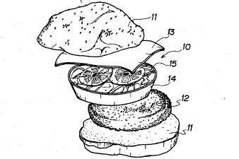
Elements Recited:
Cheese
Edible Salad
Meat Product
2 Slices of Bread

Slide 15
Accused Burger #1
Say Goodbye to Unmanageable Burgers
– Finally, the scientists at Acme Burger emerged from the depths of their laboratories. With their resurfacing, the scientists brought the latest in burger technology. This revolutionary new burger has an edible salad component, meat product and cheese, all between the two slices of bread. The edible salad component makes for a better handling burger. Look for these new burgers to hit the market early next year.

Slide 16
Accused Burger #2
Say Goodbye to Unmanageable Burgers
– Finally, the scientists at Acme Burger emerged from the depths of their laboratories. With their resurfacing, the scientists brought the latest in burger technology. This revolutionary new burger has an edible salad component and meat product, both, between the two slices of bread. The edible salad component is covered with a cheese- flavored sauce. Look for these new burgers to hit the market early next year

Slide 17




Literal Infringement Analysis
The Claimed Burger | Two Slices of Bread | Cheese | Edible Salad | Meat Product | Literal Infringement
#1 |  |  |  |  | YES
#2 |  |  |  |  | NO

Slide 18

Equivalence Infringement Analysis
T | e Claimed Burger | Two Slices of Bread | Cheese | Edible Salad | Meat Product | Infringement Under DOE
 |  |  |  |  |  | YES, if
#2 |  |  |  |  |  | cheese-
 |  |  | Cheese Flavored Dressing |  |  | flavored dressing is the legal equivalent to
 |  |  |  |  |  | cheese.

Slide 19
Types of Patent Infringement (Cont.)
Infringement
Direct Infringement
Indirect Infringement
Induced
infringement
Contributory
infringement

Slide 20
Induced Infringement
A middle party (induced infringer) enables (or help, influence or ‘induce’) a third party (direct infringer) to participate the patented invention
Help could be a form of, assembling the patented product; preparing instructions for consumer use; providing instructions that detail how to produce the patented invention or licensing plans or a process which enable the licensee to produce the patented product or process

Slide 21
Contributory Infringement
If a party contribute to the infringement of a patent claim may be held liable
Accordingly, a supplier of a particular component is held liable if the component:
Constitutes a material part of the invention;
The supplier was aware that the component “was especially made or adapted for use in an infringement of such patent”;
The component is not a staple article, and
The component was used to commit at least one act of direct infringement

Slide 22
Defenses
A person falling within the scope of a defense will not be liable for infringement though his product or process is infringing
Invalidity;
Experiment, Research or Education;
Government use;
Patent Exhaustion;
Patent Misuse; and
Inequitable Conduct

Slide 23
Invalidity
The claimed subject matter was not new
The claimed subject matter was obvious
The specification has not a sufficient written description
The specification does not enable others to practice the invention claimed

Slide 24
Experiment, Research or Education
Use of patented invention for experimentation or research is a valid defense to patent infringement
In addition to research, use of a patented invention for education to pupils is also a valid defense in India

Slide 25
Government Use
Importation, manufacture or use of a patented invention by or on behalf of the government is a valid defense
Valid only if the activity is merely related to purposes of government’s own use

Slide 26
Patent Exhaustion
The exclusive rights with respect to a product are exhausted on sale of the product by the patent holder
Applies to process patents also – on sale of a product made by the process

Slide 27
Patent Misuse
Using a patent beyond the scope of rights granted to the patent holder is called patent misuse
Any action that amounts to abuse of dominance, restraint of competition and so on

Slide 28
Inequitable Conduct
A patent holder is liable for inequitable conduct if he defrauds the patent office or provides false or misleading information to the patent office
– Disclosure of false information relating to invention, inventorship, foreign application and so on
Assessed based on the intention of patent holder and materiality of the information that has been witheld or wrongfully disclosed
Major ground for patent revocation in India

Slide 29
Remedies
Injunction;
Damages;
Accounts of profits; and
Costs

